Slide 1
CROSS-NET: IN-LINE HOLOGRAPHIC IMAGE RECONSTRUCTION AND REFOCUSING
12/01/2024
Internship Student: Haitao Zhou
Supervisors: Mazen Mel & Alexander Gatto
Final Presentation

Slide 2
Outline
Introduction
Holographic Data Simulation
Methodology
Experiment Results
Ablation Studies
Conclusions
Future Work
Appendix

Slide 3
Introduction

Slide 4


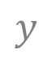
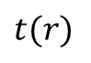

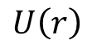



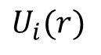

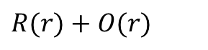
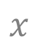
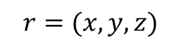
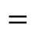

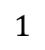
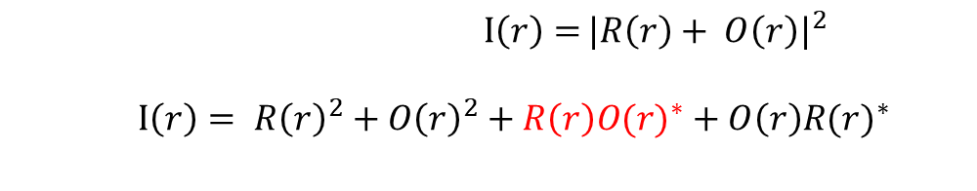
In-Line Holographic Imaging
The aim is to capture a complex field distribution (i.e., light intensity and direction).
Image sensors / films are only sensitive to light intensity.
Sensor
$$U\left(r\right)=1+t(r)$$
$$x$$
Object
Illumination wave
Illumination
Unscattered wave
Coherent light source
$$1$$
$$U_{i}(r)⋅ U\left(r\right)$$
$$t(r)$$
Scattered wave
$$=$$
$$U_{i}\left(r\right)+U_{i}(r)∙t(r)$$
$$=$$
$R(r)$ $+$ $O(r)$
$$U_{i}(r)$$
$$U\left(r\right)$$
Reference field
Latent/Object field
$$r=(x,y,z)$$
$$⨂$$
$I\left(r\right)=$ ${|R\left(r\right)+ O\left(r\right)|}^{2}$
$I\left(r\right)= {R\left(r\right)}^{2}+{O\left(r\right)}^{2}+R\left(r\right){O(r)}^{∗}+O\left(r\right){R(r)}^{∗}$
$$y$$
$$z$$
Constant
Ignored
Twin image
Latent field

Slide 5


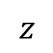
Possible Reconstruction Approaches
Deep learning: Convolutional neural networks (CNNs) , recurrent neural networks (RNNs) , generative adversarial models (GANs)
Popular methods for
holographic reconstruction
My topic focuses on deep learning methods
Iterative optimization:
Sample plane
Detector plane
Enforce object domain constraints
Hologram
Enforce detector domain constraints
Propagation
Positive absorption constraint.
Filtering mask
Denoising prior
Sparsity
Match amplitude with measured intensity.
Back-propagation
$$z$$

Slide 6
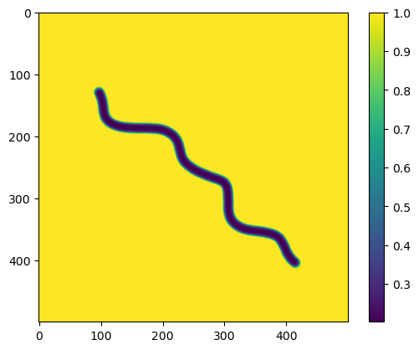
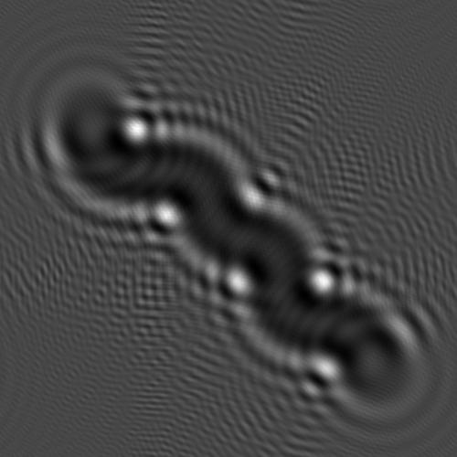
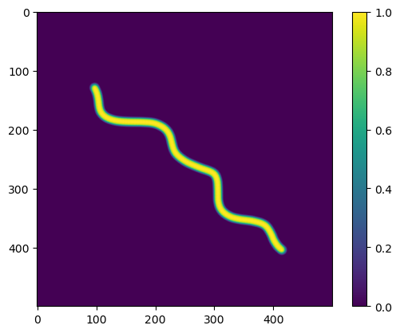
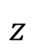

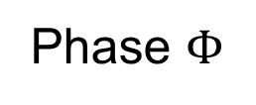
Goal
Phase $Φ$
DNN
Amplitude $A$
Hologram
$$z$$

Slide 7
Holographic Data Simulation

Slide 8
Dataset Generation
Generate image
(Stable Diffusion)
Grayscale and normalization
Form amplitude and phase
Simulate hologram
Flowchart used to generate data set

Slide 9
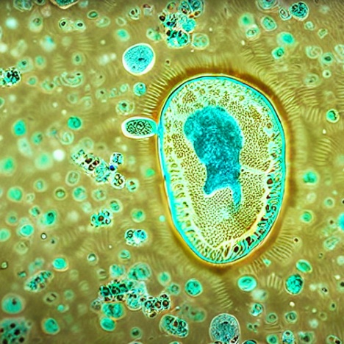
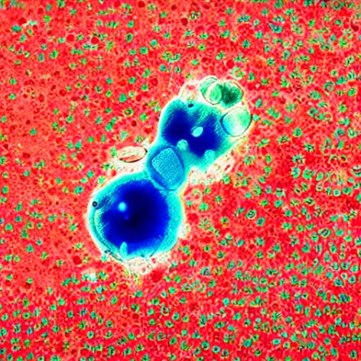
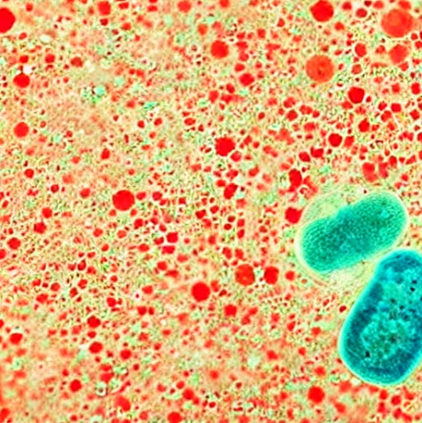
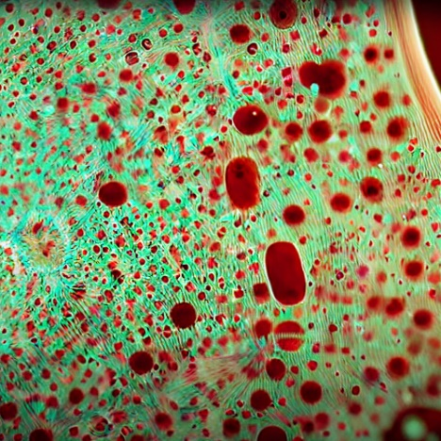
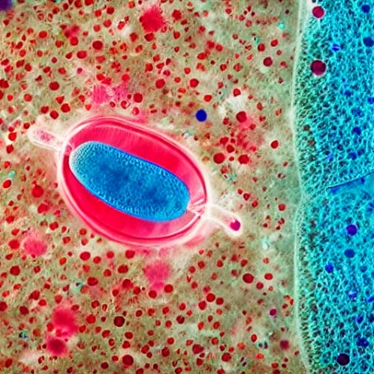
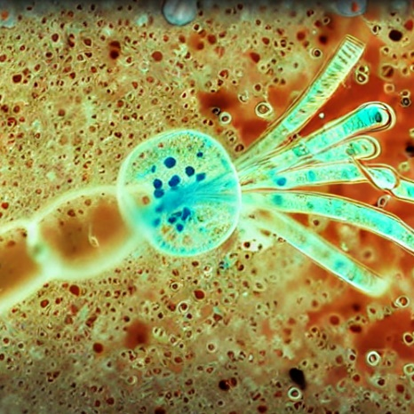
Synthetic Data Generation
A diffusion model finetuned on microscopic images is used to generate large number of training samples.
1
Fig. 3: Synthetic image samples generated by a stable diffusion model.
1
https://huggingface.co/Fictiverse/Stable_Diffusion_Microscopic_model

Slide 10
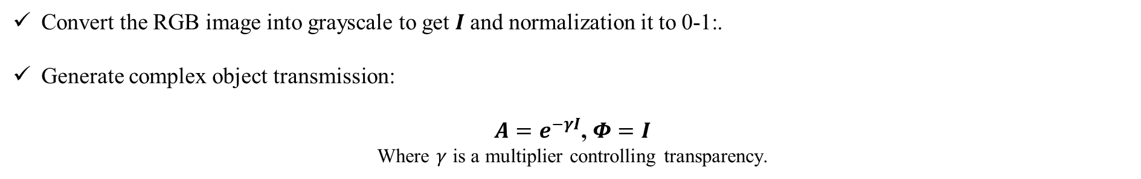
Complex Field Generation
Convert the RGB image into grayscale to get $I$and normalization it to 0-1:.
Generate complex object transmission:
$A=e^{−γI}$, $Φ=I$
Where $γ$ is a multiplier controlling transparency.

Slide 11


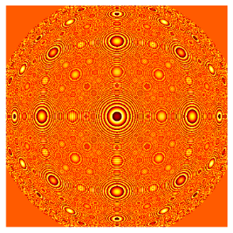

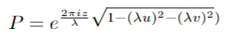
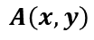
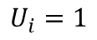
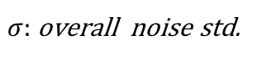

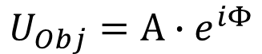
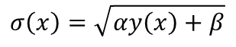

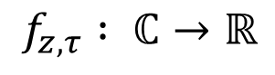
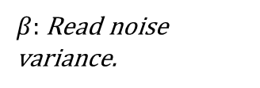


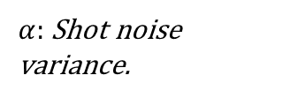
Holographic Image Formation Model
$$f_{z,τ} : ℂ→ℝ$$
Interaction
Propagation
Detection
Noise
$$U_{Obj}=A∙e^{iΦ}$$
(Planar wave)
Near-field Fresnel Propagation
Intensity image
Read + Shot noise sources
$$A\left(x,y\right)$$
$$U_{i}=1$$
Hologram
$$U_{exit}=U_{i}∙U_{Obj}$$
$$U_{d}=ℱ^{−1}\left\{ℱ\left\{U_{exit}\right\}∙P_{z}\right\}$$
$$H={\left|U_{d}\right|}^{2}$$
$$σ\left(x\right)=\sqrt{αy\left(x\right)+β}$$
$$φ\left(x,y\right)$$
$σ:$ overall noise std.
$α:$ Shot noise variance.
$β:$ Read noise variance.
Propagation kernel
${ℱ and ℱ}^{−1}:$ $Fourier and inverse fourier transform;$

Slide 12
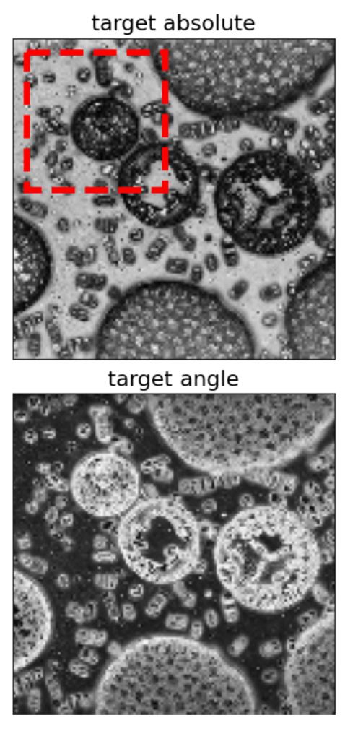
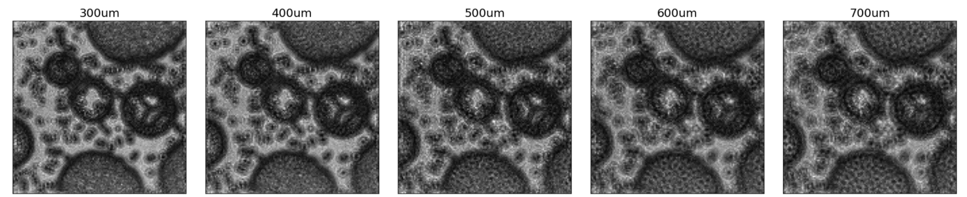
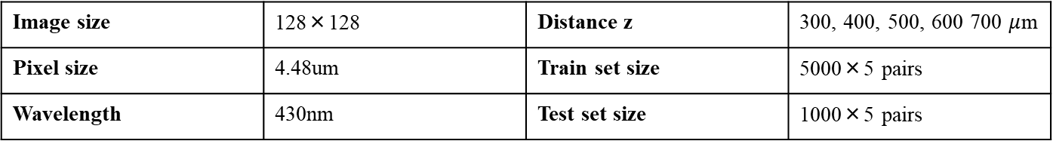
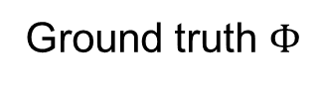
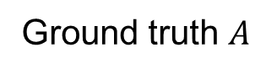
Dataset Statistics
Ground truth $A$
Image size | 128×128 | Distance z | 300, 400, 500, 600 700 $μ$m
Pixel size | 4.48um | Train set size | 5000×5 pairs
Wavelength | 430nm | Test set size | 1000×5 pairs
Parameters for data set simulation.
Ground truth $Φ$
Holograms
Generated samples
The network takes as input a hologram captured at an unknown object-detector distance z and is then tasked to reconstruct both phase and amplitude distributions of the latent complex transmission field and to estimate the distance z at which the hologram was recorded.

Slide 13
Methodology

Slide 14
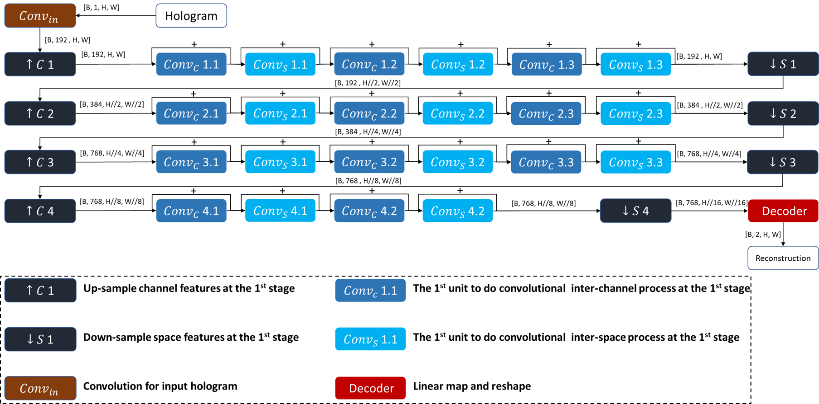
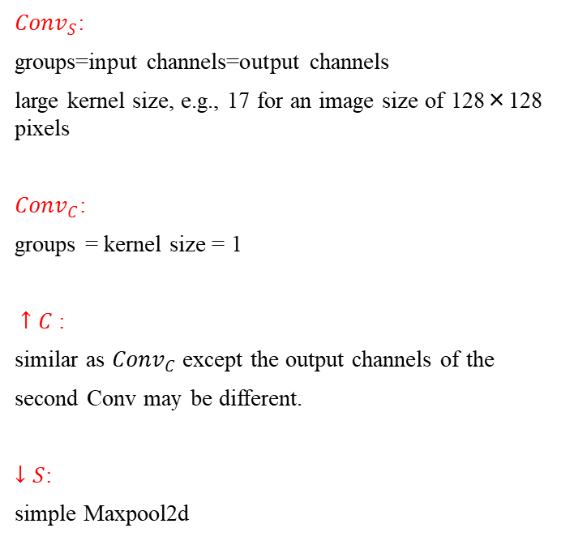
Propose Approach “Cross-Net”
${Conv}_{S}$:
groups=input channels=output channels
large kernel size, e.g., 17 for an image size of 128×128 pixels
${Conv}_{C}$:
groups = kernel size = 1
$↑C$:
similar as ${Conv}_{C}$ except the output channels of the
second Conv may be different.
$↓S$:
simple Maxpool2d
Detailed architecture of reconstruction branch in Cross-Net
Notes:
We opted for such architecture to address the shortcomings of the standard transformer model

Slide 15
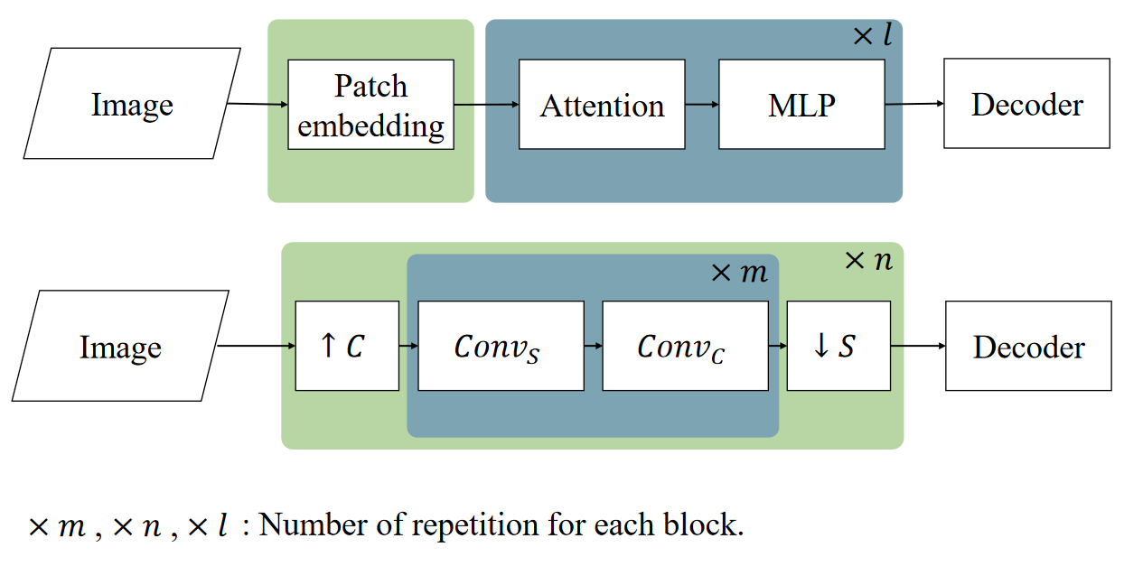
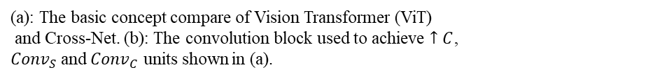
Propose Approach “Cross-Net”
[1,128,128]
Patch embedding
(conv2d with stride = kernel size)
[768,8,8]
Feature vector
Input
Information loss, consistent global features are cut, fine features are compressed
(a)
Decompose patch embedding, access to medium latent vectors.
Quadratic runtime with respect to image size, not suitable for medium vectors.
Over-fit and high resource consumption caused by big module size.
(b)
(a): The basic concept compare of Vision Transformer (ViT)
and Cross-Net. (b): The convolution block used to achieve $↑C$,
${Conv}_{S}$and ${Conv}_{C}$ units shown in (a).
Use special convolution blocks as inter-spatial processing units.
Notes:
Spend less time as possible

Slide 16
Overall Architecture
Reconstruction branch
Same transmission reconstruction
Hologram of the
same object with
different z
Regression branch
Different distance estimate
Input
Cross-Net
Output
Schematic of Cross-Net’s two-branch architecture
The two branches have similar architecture.
Decoder of regression branch: average pool and linear mapping.
Decoder of reconstruction branch: linear mapping and reshape .

Slide 17
Information of ViT and Cross-Net used for later experiment.
 | ViT | Cross-Net
Reconstruction branch size | 43.2 m | 10.5 m
Regression branch size | 19.1 m | 7.5 m
Reconstruction latent vector shape | [B, 64, 768] | [B, 768, 8, 8]
Regression latent shape | [B, 256, 512] | [B, 512, 16, 16]

Slide 18
Benchmarks
Model name | Description
HRNet | HRNet uses a deep residual network as encoder and simple periodic shuffling as a decoder.
Dense-U-Net | Dense-U-net is an upgraded version of U-net, it adds specially designed dense blocks to the traditional U-net.
Fourier Imager Network(FIN) | The FIN architecture is based on spatial Fourier transform modules that process the spatial frequencies of its inputs using learnable filters and a global receptive field.
Ehanced Fourier Imager Network(eFIN) | Compared to FIN, eFIN uses a shallow U-net to extract filters of spatial frequencies and features needed for refocusing.

Slide 19
Experimental Results

Slide 20
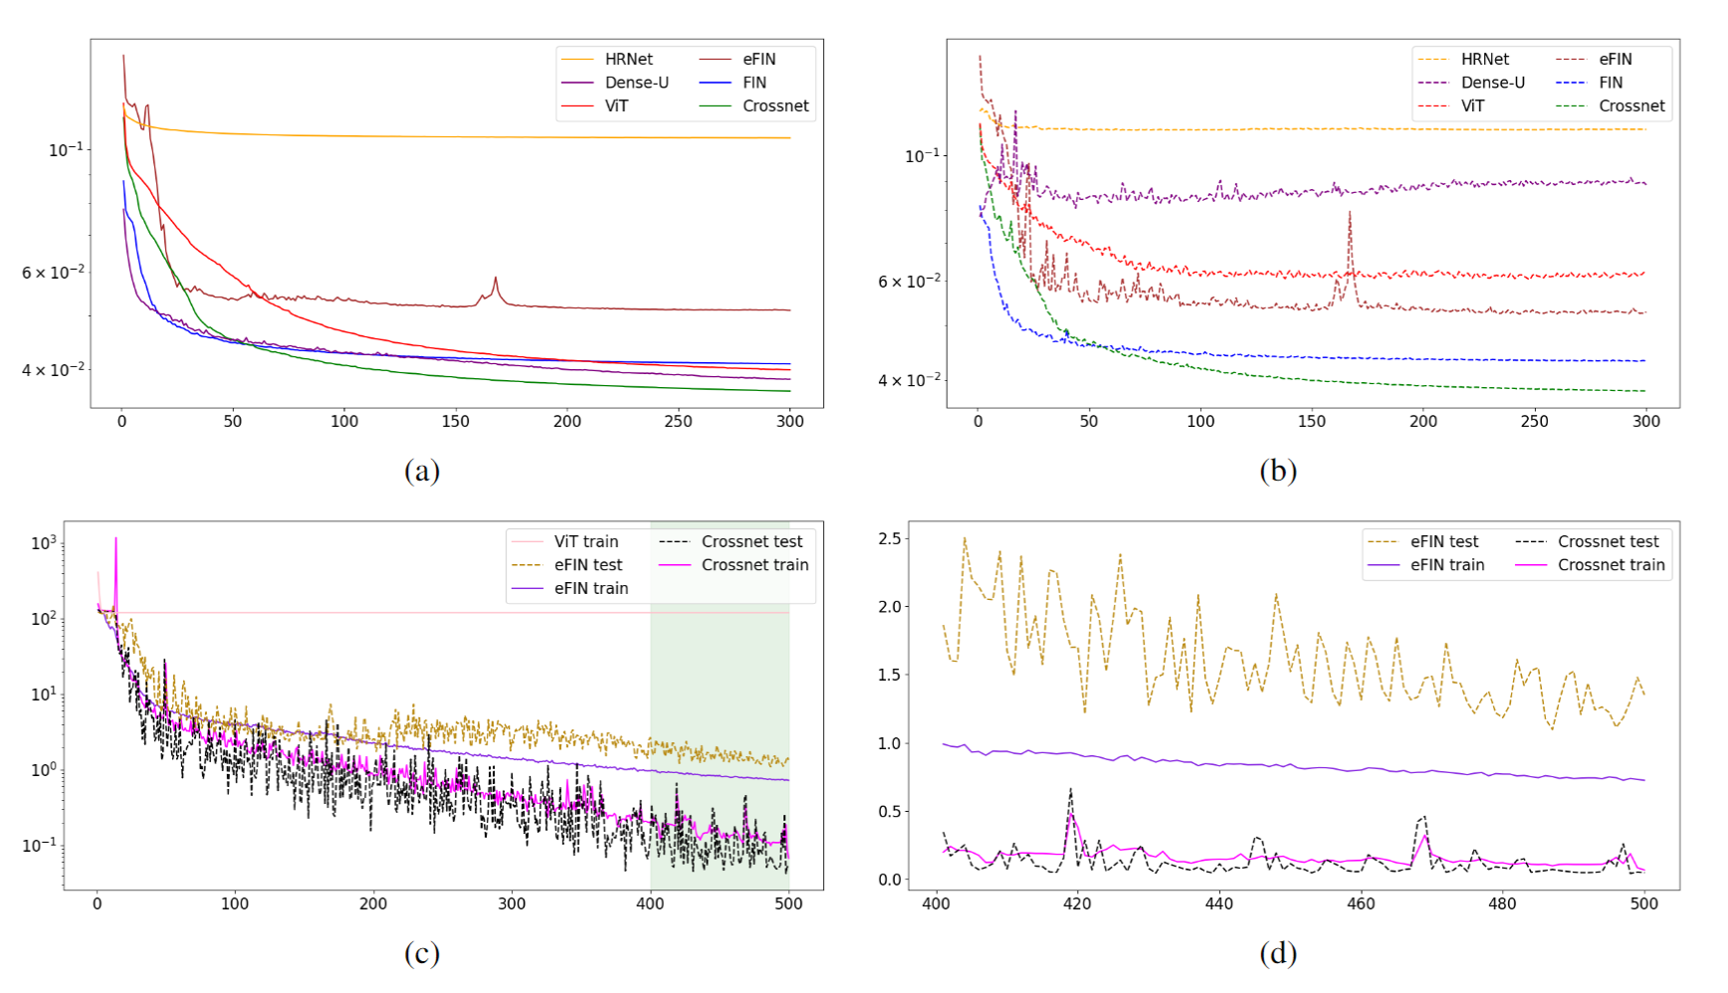
Experiment results: Loss curves
 | Train loss | Test loss
FIN | 0.0409 | 0.0432
eFIN | 0.0512 | 0.0528
Cross-Net | 0.0366 | 0.0383
The train loss and test loss of FIN, eFIN and Cross-Net at epoch 300
The training of eFIN is very unstable
ViT converges all regressions to 500um which is the median of 300um - 700um.
The ticks on the x-axis mean the number of epochs. (a): L1 loss of reconstruction on the train set. (b): L1 loss of reconstruction on the test set. (c): L1 loss of distance z regression (d): Zoom in of the region with green shadow in (c). The plot (d) uses a linear scale instead of a logarithmic scale.

Slide 21
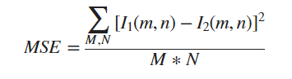
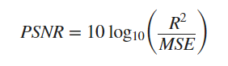
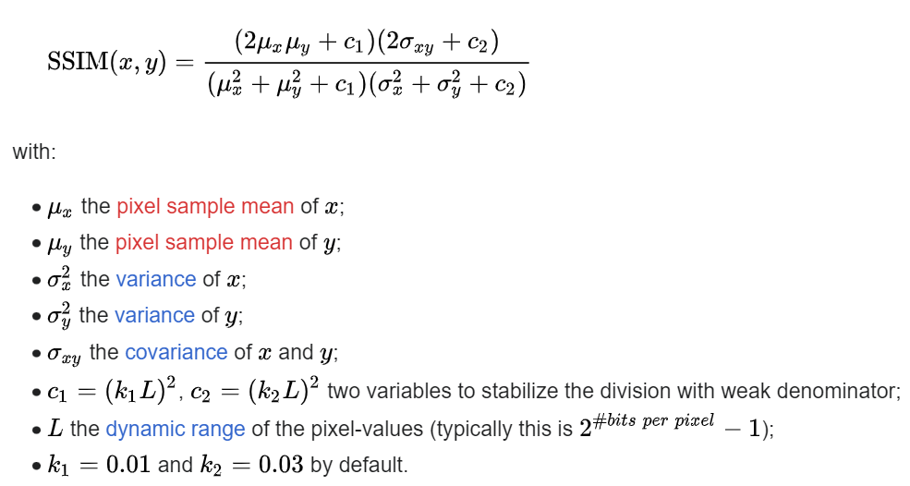
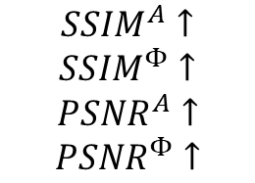
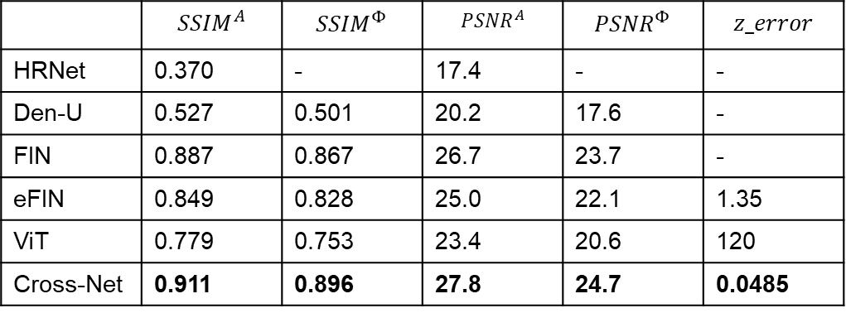
Experiment results: Metrics on test set
 | $${SSIM}^{A}$$ | $${SSIM}^{Φ}$$ | $${PSNR}^{A}$$ | $${PSNR}^{Φ}$$ | $$z_error$$
HRNet | 0.370 | - | 17.4 | - | -
Den-U | 0.527 | 0.501 | 20.2 | 17.6 | -
FIN | 0.887 | 0.867 | 26.7 | 23.7 | -
eFIN | 0.849 | 0.828 | 25.0 | 22.1 | 1.35
ViT | 0.779 | 0.753 | 23.4 | 20.6 | 120
Cross-Net | 0.911 | 0.896 | 27.8 | 24.7 | 0.0485
R is the maximum fluctuation in the input image data type
Metrics to show average reconstruction and regression quality on test set.
$${SSIM}^{A}↑$$
$${SSIM}^{Φ}↑$$
$${PSNR}^{A}↑$$
$${PSNR}^{Φ}↑$$
Better quality
Notes:
Rewrite the tables
make cross net values bold

Slide 22
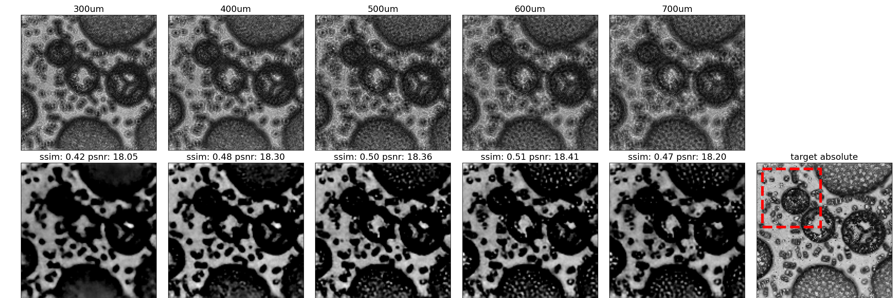
Experiment results: Sample
Introduce from the worst model
to the best model.
Hologram
Target Amplitude
Reconstruction
Amplitude
HRNet

Slide 23
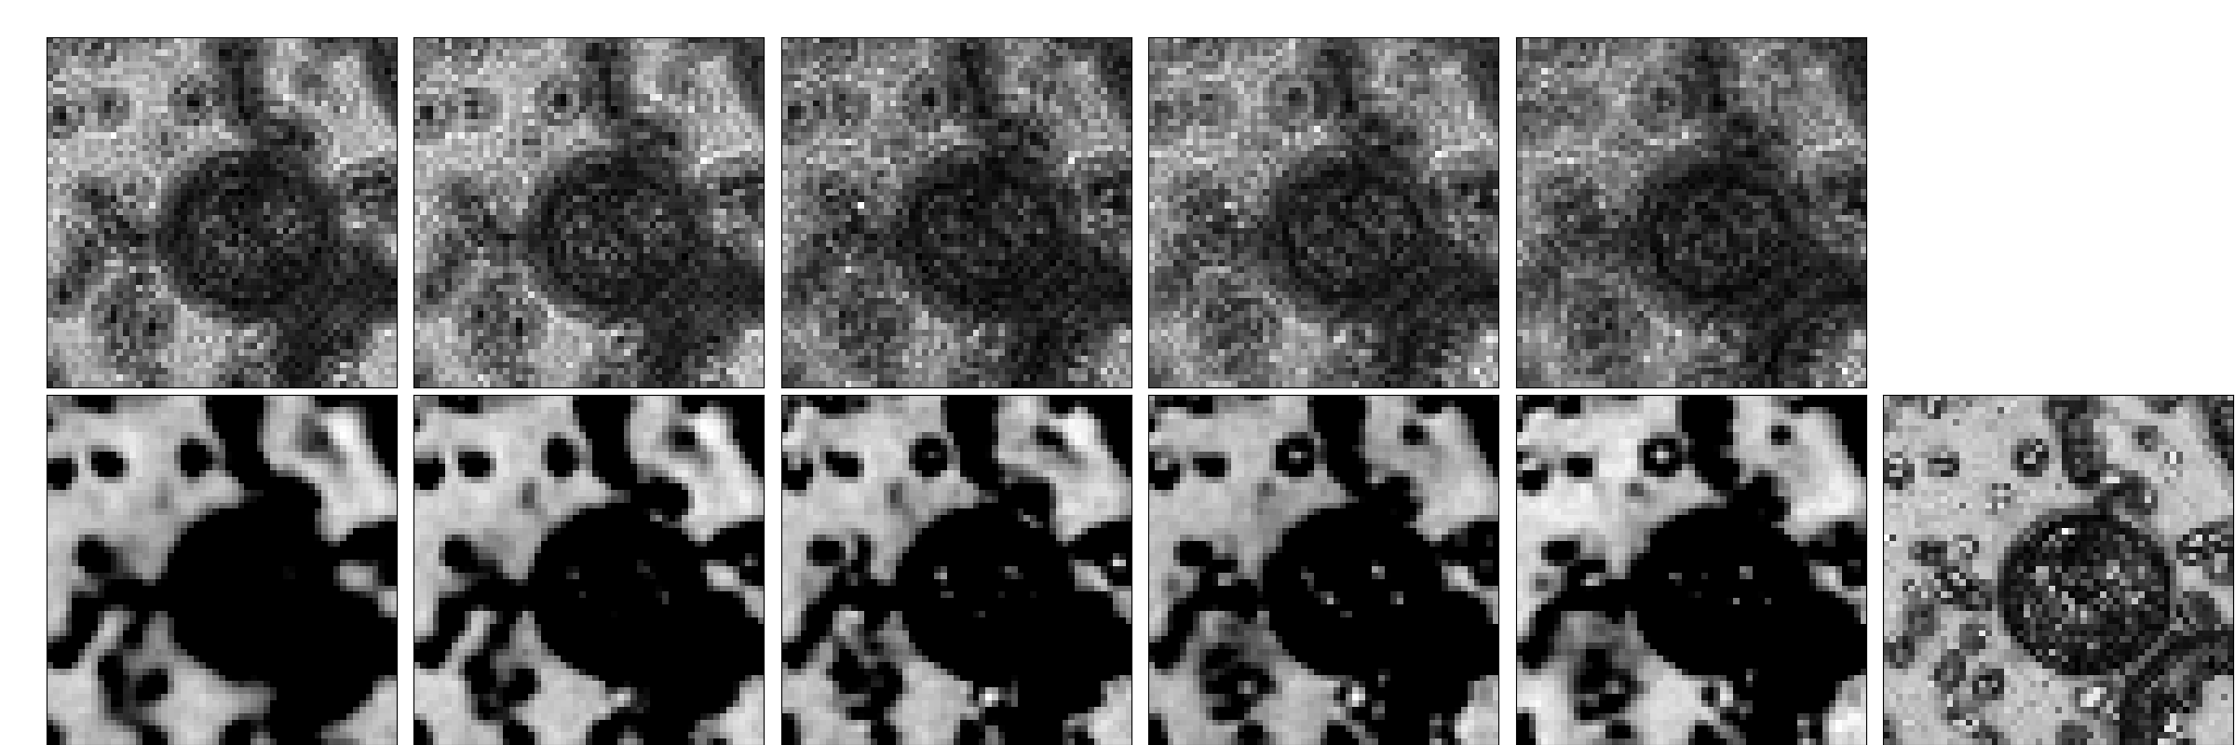
Experiment results: Sample
Hologram
Target Amplitude
Reconstruction
Amplitude
HRNet Zoom in

Slide 24

Experiment results: Sample
Hologram
Target Amplitude
Reconstruction
Amplitude
Reconstruction
Phase
Dense-U-net
Target Phase

Slide 25

Experiment results: Sample
Hologram
Target Amplitude
Reconstruction
Amplitude
Reconstruction
Phase
Dense-U-net Zoom in
Target Phase

Slide 26

Experiment results: Sample
Hologram
Target Amplitude
Reconstruction
Amplitude
Reconstruction
Phase
Target Phase
ViT

Slide 27

Experiment results: Sample
Hologram
Target Amplitude
Reconstruction
Amplitude
Reconstruction
Phase
ViT Zoom in
Target Phase

Slide 28

Experiment results: Sample
Hologram
Target Amplitude
Reconstruction
Amplitude
Reconstruction
Phase
eFIN
Target Phase

Slide 29

Experiment results: Sample
Hologram
Target Amplitude
Reconstruction
Amplitude
Reconstruction
Phase
eFIN Zoom in
Target Phase

Slide 30

Experiment results: Sample
Hologram
Target Amplitude
Reconstruction
Amplitude
Reconstruction
Phase
FIN
Target Phase

Slide 31

Experiment results: Sample
Hologram
Target Amplitude
Reconstruction
Amplitude
Reconstruction
Phase
FIN Zoom in
Target Phase

Slide 32

Experiment results: Sample
Hologram
Target Amplitude
Reconstruction
Amplitude
Reconstruction
Phase
Cross-Net
Target Phase

Slide 33

Experiment results: Sample
Hologram
Target Amplitude
Reconstruction
Amplitude
Reconstruction
Phase
CrossNet Zoom in
Target Phase

Slide 34












Experiment results: External generalization
The network is trained on synthetic images generated by a stable diffusion model and tested outer QPI data with different overall statistics.
Images with same training set statistics
Images with completely different statistics

Slide 35


Experiment result: External generalization
 | $${SSIM}^{A}$$ | $${SSIM}^{Φ}$$ | $${PSNR}^{A}$$ | $${PSNR}^{Φ}$$ | $$z_error$$
FIN | 0.917 | 0.908 | 33.2 | 31.2 | -
eFIN | 0.752 | 0.742 | 26.9 | 25.0 | 41.1
Cross-Net | 0.935 | 0.927 | 34.2 | 32.2 | 0.821
Cross-Net has Very good external generalization
Metrics valid set
 | $${SSIM}^{A}$$ | $${SSIM}^{Φ}$$ | $${PSNR}^{A}$$ | $${PSNR}^{Φ}$$ | $$z_error$$
HRNet | 0.370 | - | 17.4 | - | -
Den-U | 0.527 | 0.501 | 20.2 | 17.6 | -
FIN | 0.887 | 0.867 | 26.7 | 23.7 | -
eFIN | 0.849 | 0.828 | 25.0 | 22.1 | 1.35
ViT | 0.779 | 0.753 | 23.4 | 20.6 | 120
Cross-Net | 0.911 | 0.896 | 27.8 | 24.7 | 0.0485
Metrics test set

Slide 36

Experiment result: External generalization sample
Hologram
Target Amplitude
Reconstruction
Amplitude
Reconstruction
Phase
eFIN
Target Phase

Slide 37

Experiment result: External generalization sample
Hologram
Target Amplitude
Reconstruction
Amplitude
Reconstruction
Phase
eFIN Zoom in
Target Phase

Slide 38

Experiment result: External generalization sample
Hologram
Target Amplitude
Reconstruction
Amplitude
Reconstruction
Phase
Cross-Net
Target Phase

Slide 39

Experiment result: External generalization sample
Hologram
Target Amplitude
Reconstruction
Amplitude
Reconstruction
Phase
Cross-Net Zoom in
Target Phase

Slide 40
Experimental Results

Slide 41


Experiment result: Ablation Studies
Fig. 15: The result of ablation studies.
SPE (Single-step Patch Embedding): Use a single-step Patch Embedding with one stage of ${Conv}_{S}$ and ${Conv}_{C}$ and have similar size as Cross-Net.
SPE att s: Replace ${Conv}_{S}$ with attention, decrease the number of inter-spatial and inter-channel processing units to keep similar size as SPE.
SPE att c: Replace ${Conv}_{S}$ with attention, keep the same cycles of processing units.
Cross-Net BN: Replace weight normalization with batch normalization.

Slide 42
Conclusions
Achieved joint computational re-focusing and holographic image reconstruction.
Proposed novel Patch Embedding decomposition and redesigned the inter-spatial processing units of the standard ViT model.
Demonstrated competitive results with state-of-the-art approaches.

Slide 43
Future work
Add spatial super-resolution capability as it can be achieved by changing the output channels of the linear mapping layer in the decoder.
Target performance on real holographic data captured by Sony’s DIHM prototype.

Slide 44
Appendix

Slide 45
Appendix: Other trials
Try to improve Fourier Imager Network(FIN).
Make the spatial frequency filters as a kind of half fixed format, and only optimize several hyperparameters. It fails.
Try to improve U-Net.
Put something on the skip connection, like spatial frequency filters or spatial processing. Use U-Net as the basic units of RNN. It fails.
Try to improve RNN.
Use U-Net as the basic units of RNN. It fails.
Try to output directly phase at sensor plane.
Output directly sensor-plane phase can half the capacity requirement for the model. But the errors will spread after back propagation causing low
SSIM and PSNR. It fails.

Slide 46

State-of-the-art Competing Approaches
HRNet uses a deep residual network as encoder and simple periodic shuffling as a decoder.
Fig. 9: Schematic of the deep learning workflow and the structure of HRNet
Zhenbo Ren, Zhimin Xu, and Edmund Y Lam, “End-to-end deep learning framework for digital holographic reconstruction,” Advanced Photonics, vol. 1, no. 1, pp.016004–016004, 2019.
Notes:
One slide big table

Slide 47

State-of-the-art Competing Approaches
Dense-U-net is an upgraded version of U-net, it adds specially designed dense blocks to the traditional U-net.
Fig. 10: Schematic of the deep learning workflow and the structure of Dense-U-net
Yufeng Wu, Jiachen Wu, Shangzhong Jin, Liangcai Cao, and Guofan Jin, “Dense-u-net: dense encoder decoder network for holographic imaging of 3d particle fields,”
Optics Communications, vol. 493, pp. 126970, 2021.

Slide 48

State-of-the-art Competing Approaches
Fig. 11: Schematic of the deep learning workflow and the structure of FIN
The FIN architecture is based on spatial Fourier transform modules that process the spatial frequencies of its inputs using learnable filters and a global receptive field.
Hanlong Chen, Luzhe Huang, Tairan Liu, and Aydogan Ozcan, “Fourier imager network (fin): A deep neural network for hologram reconstruction with superior external generalization,
” Light: Science & Applications,vol. 11, no. 1, pp. 254, 2022.

Slide 49

State-of-the-art Competing Approaches
Compared to FIN, eFIN uses a shallow U-net to extract filters of spatial frequencies and features needed for refocusing.
Fig. 12: Schematic of the deep learning workflow and the structure of eFIN.
Hanlong Chen, Luzhe Huang, Tairan Liu, and Aydogan Ozcan, “efin: Enhanced fourier imager network for generalizable autofocusing and pixel super-resolution in holographic imaging,”
IEEE Journal of Selected Topics in Quantum Electronics, vol. 29, no. 4: Biophotonics, pp. 1–10, 2023.

Slide 50
Method: Propose Cross-Net
 | ViT | Cross-Net
Reconstruction branch size | 43.2 m | 10.5 m
Regression branch size | 19.1 m | 7.5 m
Reconstruction latent vector shape | [B, 64, 768] | [B, 768, 8, 8]
Regression latent shape | [B, 256, 512] | [B, 512, 16, 16]
Information of ViT and Cross-Net used for later experiment.
Kaiming He, Xinlei Chen, Saining Xie, Yanghao Li, Pi- otr Doll ́ar, and Ross Girshick, “Masked autoencoders are scalable vision learners,” in Proceedings of the IEEE/CVF conference on computer vision and pattern recognition, 2022, pp. 16000–16009.
Ross Wightman, “Pytorch image mod- els,” https://github.com/rwightman/ pytorch-image-models, 2019.

Slide 51

Holograms
Target amplitude
Reconstruction
amplitude
Reconstruction
phase
Target phase

